Slide 1
Chapter 4.7, 5.1, 5.2, 5.7, 5.8 Protein Structure/Function Overview Techniques for Protein Purification and Characterization

Slide 2
Outline
Protein functions
Protein terminology and types
Levels of protein structure: primary, secondary, tertiary, quaternary

Slide 3
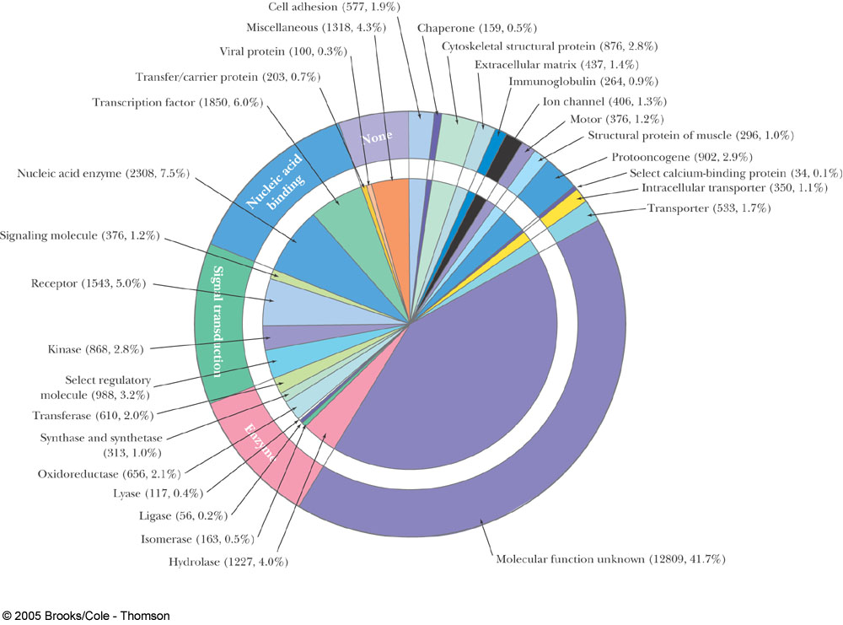
Fig. 5-26
Proteins Encoded by the Human Genome, Grouped by Function

Slide 4
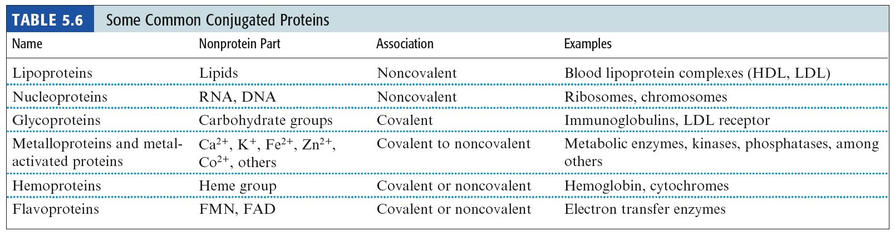
5.8 What Are the Many Biological Functions of Proteins?
The functionality of proteins can be enhanced by post-translational binding of co-factors (usually small, noncovalent, needed for enzyme activity) and prosthetic groups (usually covalent).

Slide 5
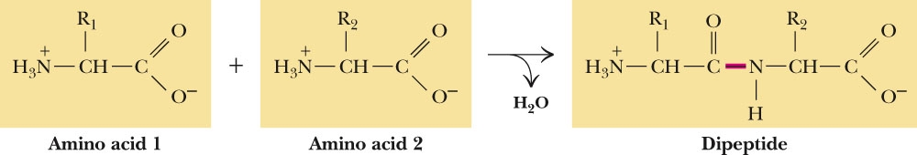
Sec. 4.7 What is the Fundamental Structural Pattern in Proteins?
Figure 4.14 Peptide formation is the creation of an amide bond between the carboxyl group of one amino acid and the amino group of another amino acid.

Slide 6
4.7 What is the Fundamental Structural Pattern in Proteins?
Proteins are unbranched polymers of amino acids
Proteins may be composed of one or more polymer chains
The peptide backbone of a protein consists of the repeated sequence –N-C_{α}-C_{o}-
“N” is the amide nitrogen of the amino acid
“C_{α}” is the alpha-C of the amino acid
“C_{o}” is the carbonyl carbon of the amino acid

Slide 7
“Peptides”
Short polymers of amino acids
Each amino acid unit is called a residue
2 residues – dipeptide
3 residues – tripeptide
12-20 residues – oligopeptide
>20 residues – polypeptide
Polypeptides above 50 residues – protein

Slide 8
“Protein”
One polypeptide chain - a monomeric protein
More than one - multimeric protein
Homomultimer - one kind of chain
Heteromultimer - two or more different chains
Hemoglobin, for example, is a heterotetramer.
It has two alpha chains and two beta chains held
together by weak interactions.
.

Slide 9
“Protein”
Classified By Shape
Fibrous – Collagen
Elastin
Fibroin (silk)
Keratin (wool, hair, skin, horn)
Globular – Most proteins and enzymes
Classified By Solubility in Aqueous Solutions
Soluble – e.g. Cytosolic
Insoluble – e.g. Membrane-bound or structural

Slide 10
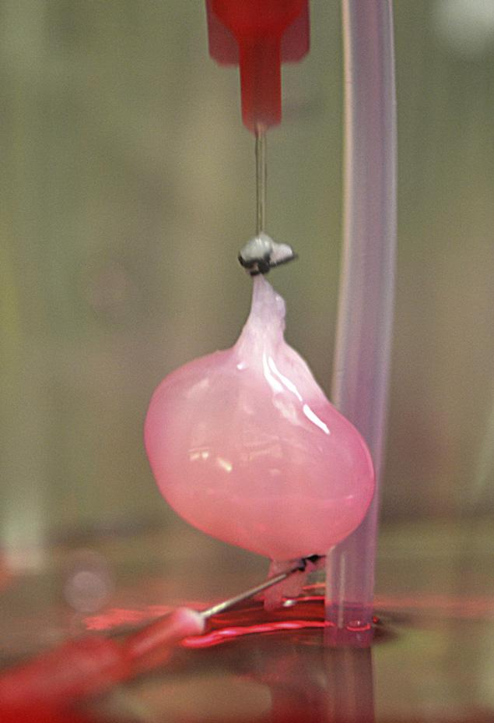
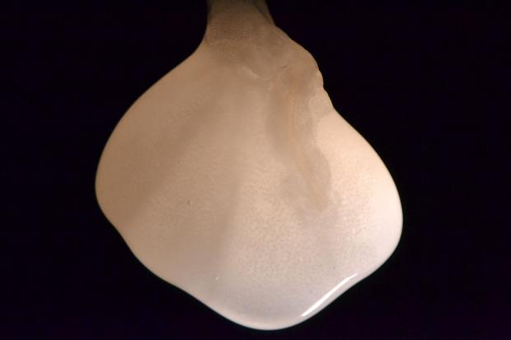
Bioengineered organs
The insoluble collagen scaffolding of a rat kidney, left behind after removing all cells with mild detergent.
Ott Laboratory, Massachusetts General Hospital Center for Regenerative Medicine, April 2013
To create a functional lab-made kidney, the scaffolding was reseeded with rat neonatal kidney cells and human endothelial cells.

Slide 11
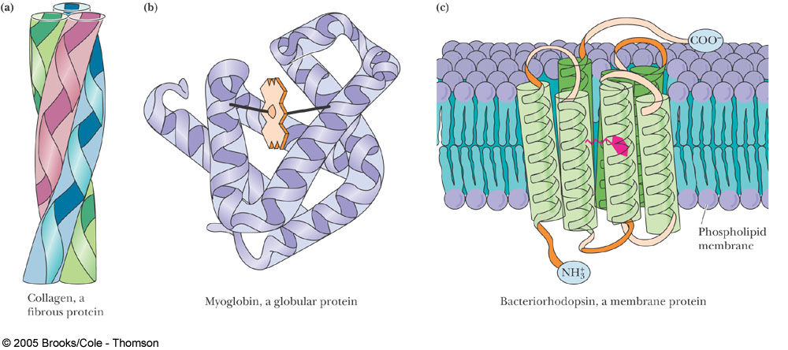
(a) Proteins having structural roles in cells are typically fibrous and often water insoluble. Collagen is a good example. Collagen is composed of three polypeptide chains that intertwine. (b) Soluble proteins serving metabolic functions can be characterized as compactly folded globular molecules, such as myoglobin. The folding pattern puts hydrophilic amino acid side chains on the outside and buries hydrophobic side chains in the interior, making the protein highly water soluble. (c) Membrane proteins fold so that hydrophobic amino acid side chains are exposed in their membrane-associated regions. The portions of membrane proteins extending into or exposed at the aqueous environments are hydrophilic in character, like soluble proteins. Bacteriorhodopsin is a typical membrane protein; it binds the light-absorbing pigment, cis-retinal, shown here in red. (a, b, Illustration: Irving Geis. Rights owned by Howard Hughes Medical Institute. Not to be reproduced without permission.)

Slide 12
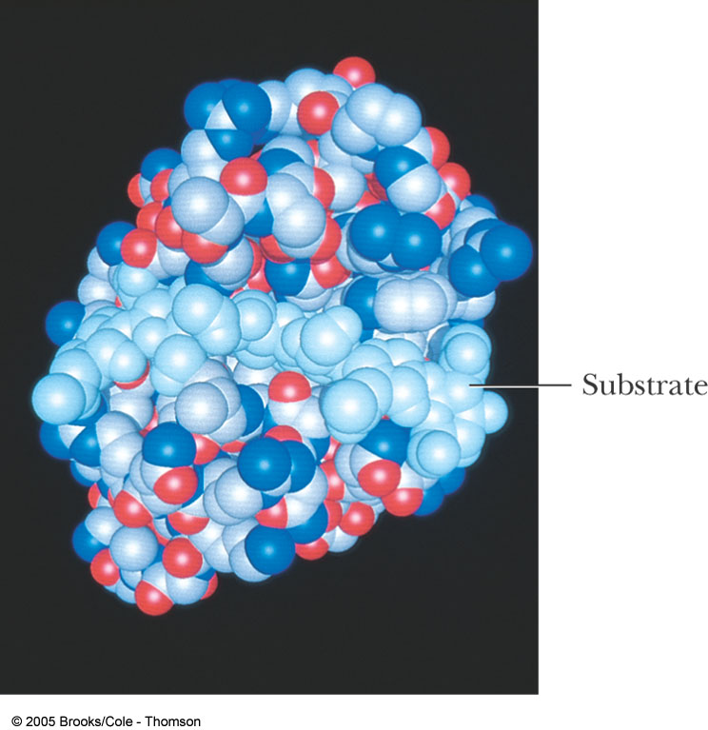
Space-filling model of the soluble, globular enzyme lysozyme with bound oligosaccharide substrate.
Notes:
FIGURE 14.36 The lysozyme-enzyme–substrate complex.

Slide 13
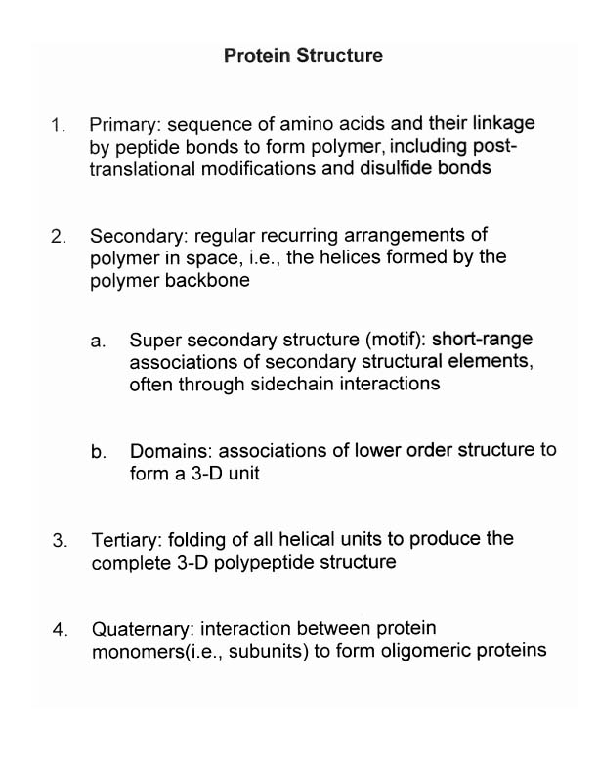

Slide 14
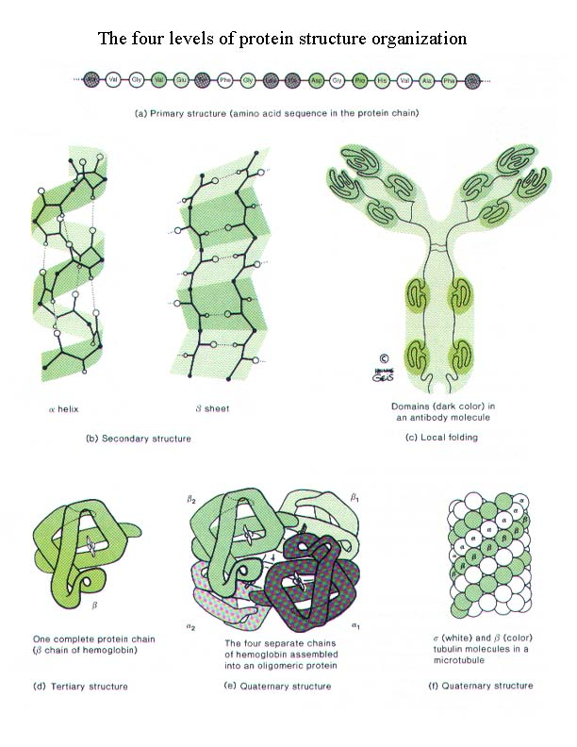

Slide 15
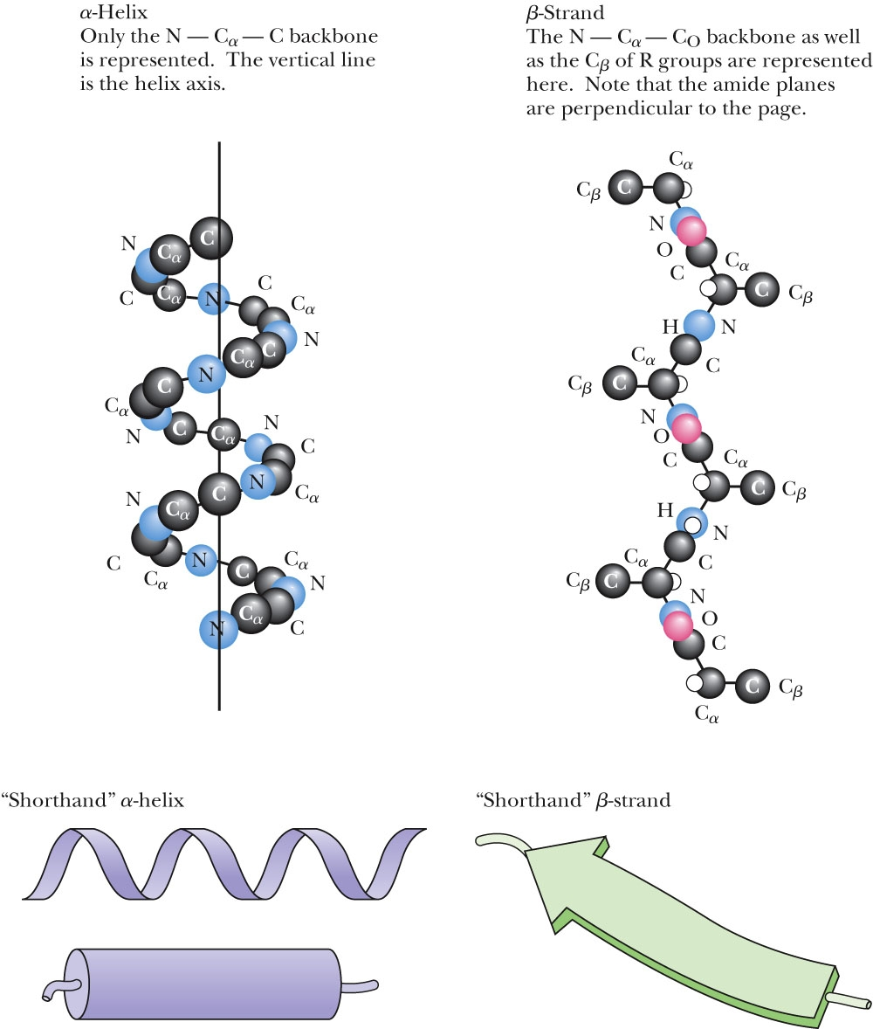
5.1 What Architectural Arrangements Characterize Protein Structure?
Secondary structures in proteins
Figure 5.3 The α-helix and the β-pleated strand are the two principal secondary structures found in proteins.

Slide 16
Outline: Techniques for Protein Purification and Characterization
Electrophoresis
Paper/PAGE/SDS-PAGE/Isoelectric Focusing
Centrifugation
Velocity/Differential/Density Gradient
Chromatography
Ion/Reverse Phase/Affinity/Gel Filtration
Dialysis/Ultrafiltration
Salting In/Salting Out

Slide 17
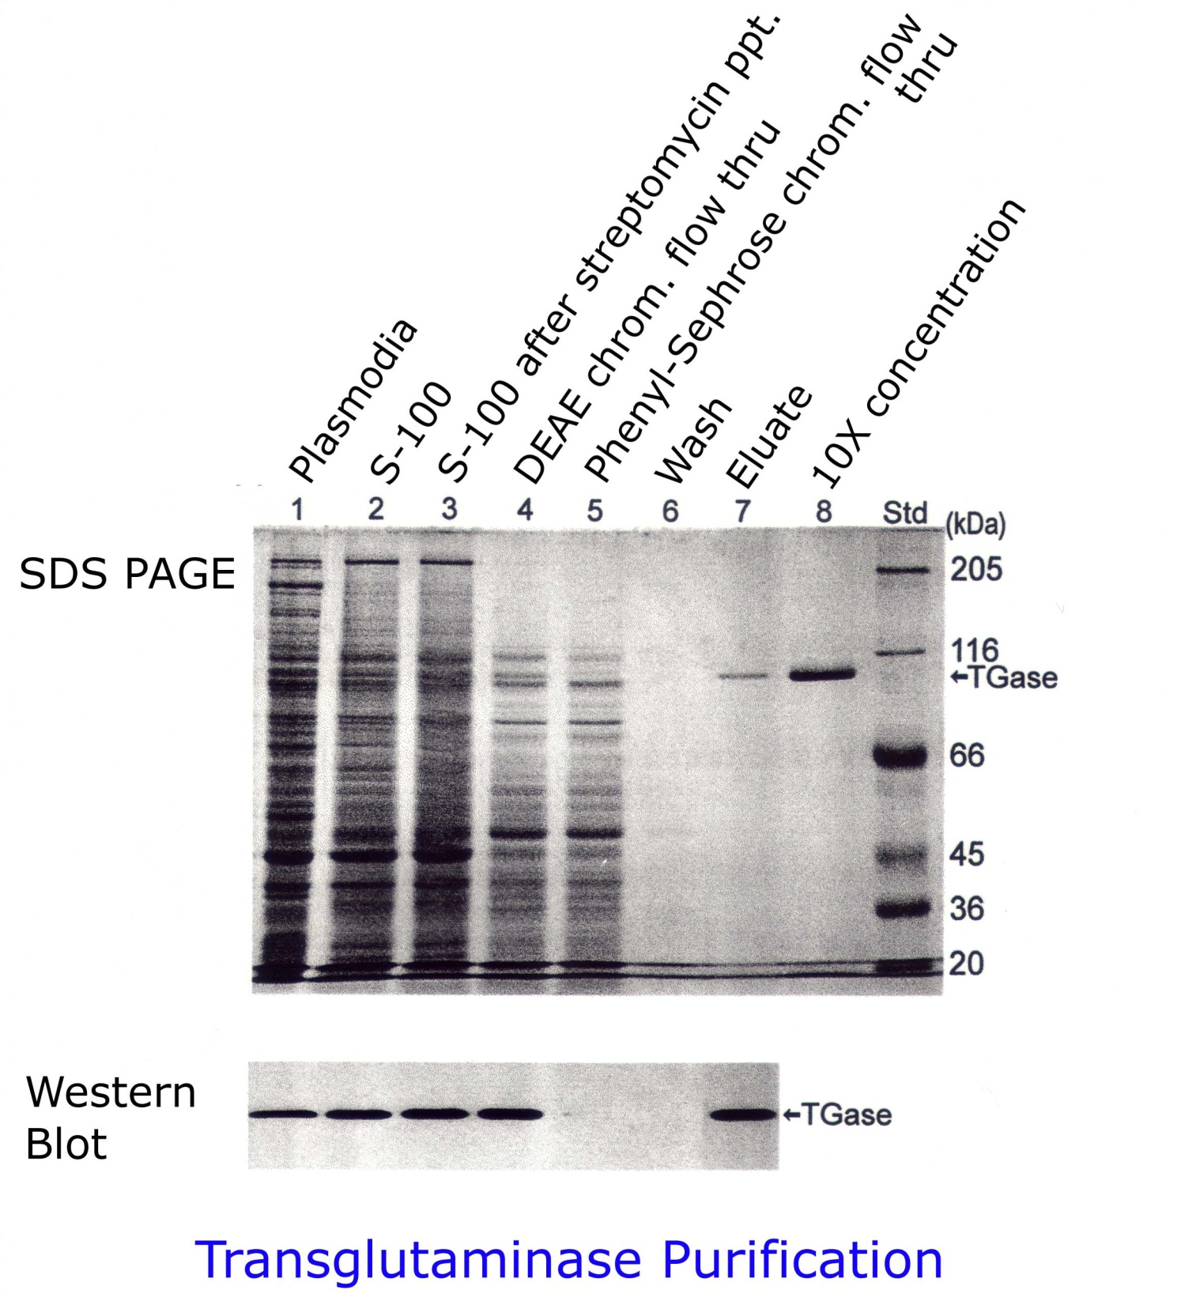

Slide 18
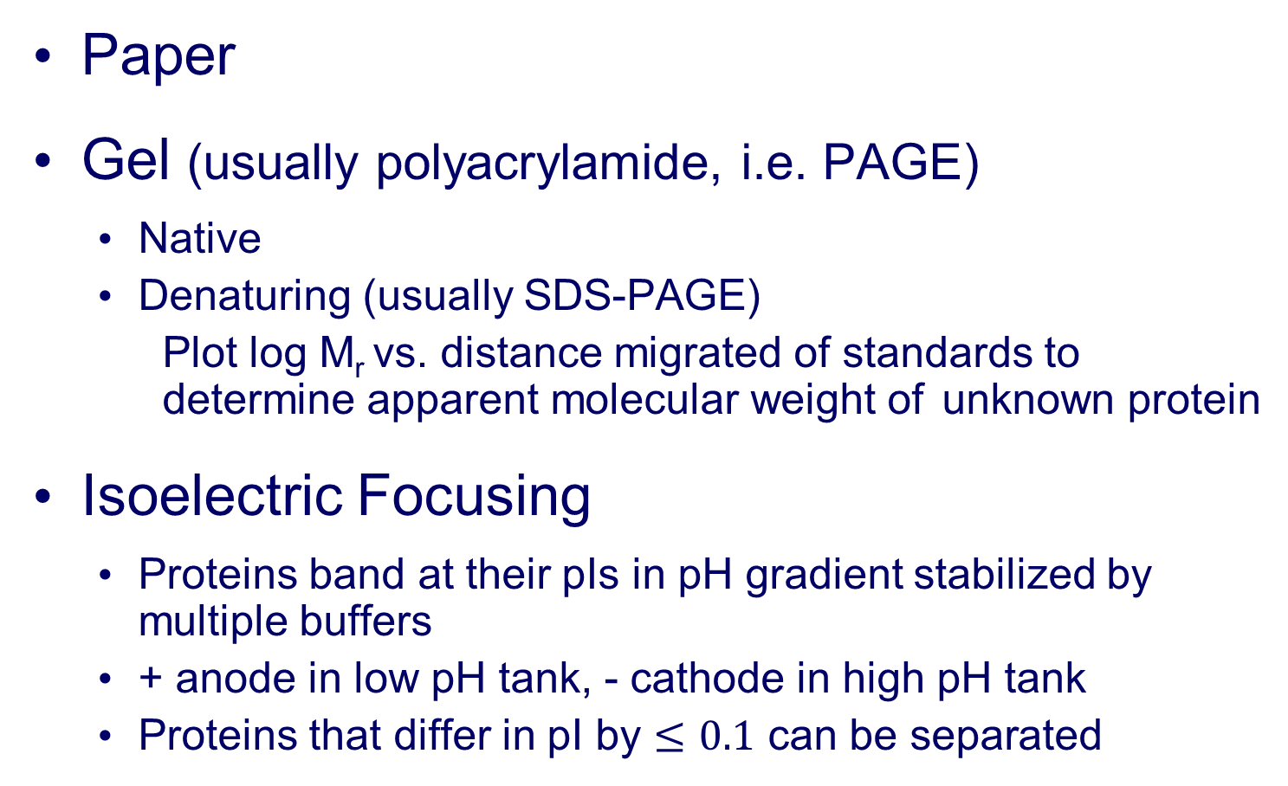
Electrophoresis

Slide 19
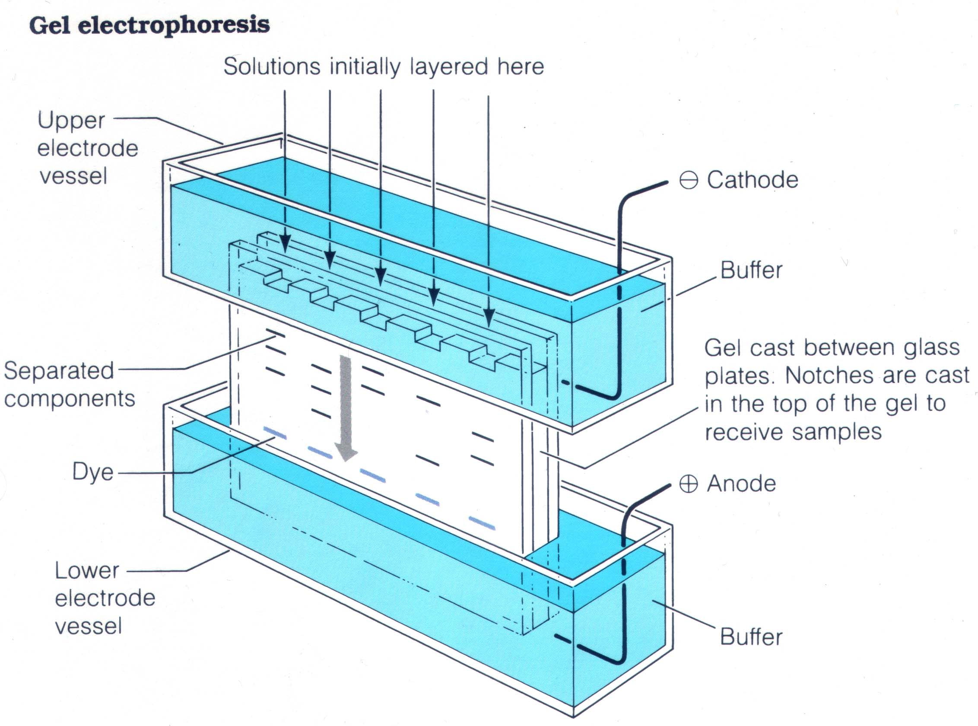

Slide 20
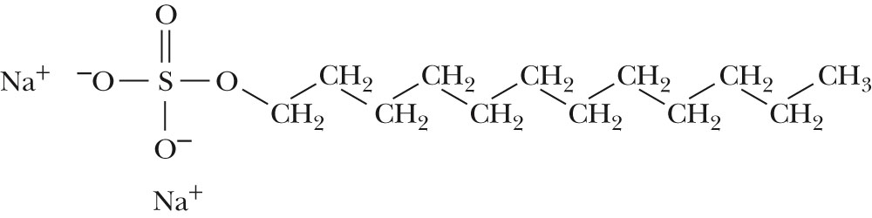
SDS-Polyacrylamide Gel Electrophoresis (SDS-PAGE)
Techniques, Figure 5, p. 113
The structure of sodium dodecyl sulfate (SDS).

Slide 21
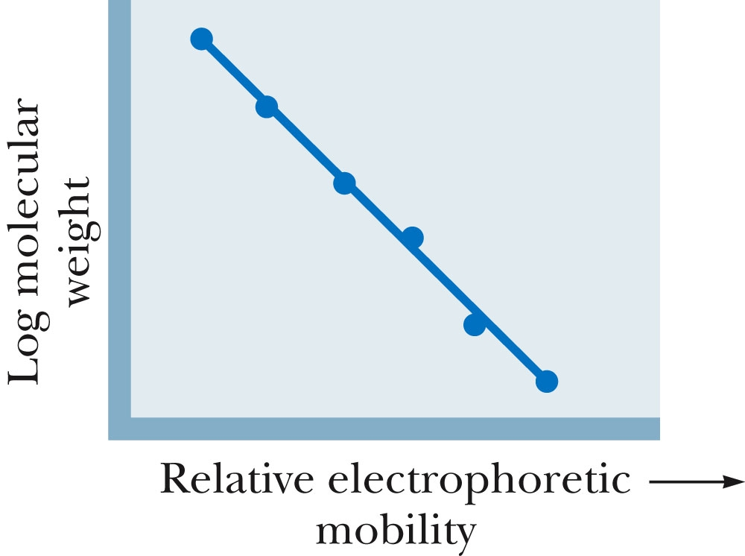
SDS-Polyacrylamide Gel Electrophoresis (SDS-PAGE)
Techniques, Figure 6, p. 113 A plot of protein mobility versus log of molecular weight of individual proteins.

Slide 22
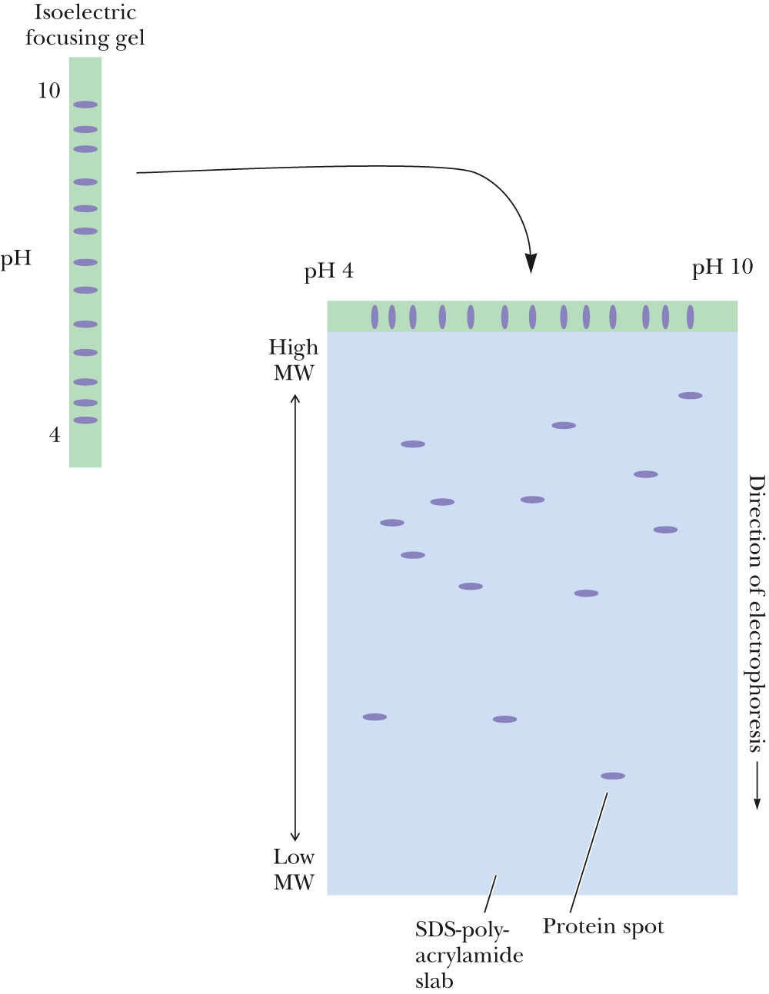
Two-Dimensional Gel Electrophoresis
Techniques, Figure 7, p. 114
A two-dimensional electrophoresis separation. Macromolecules are first separated according to charge by isoelectric focusing in a tube gel. The gel containing separated molecules is then place on top of an SDS-PAGE slab, and the molecules are electrophoresed into the SDS-PAGE gel, where they are separated according to size.

Slide 23
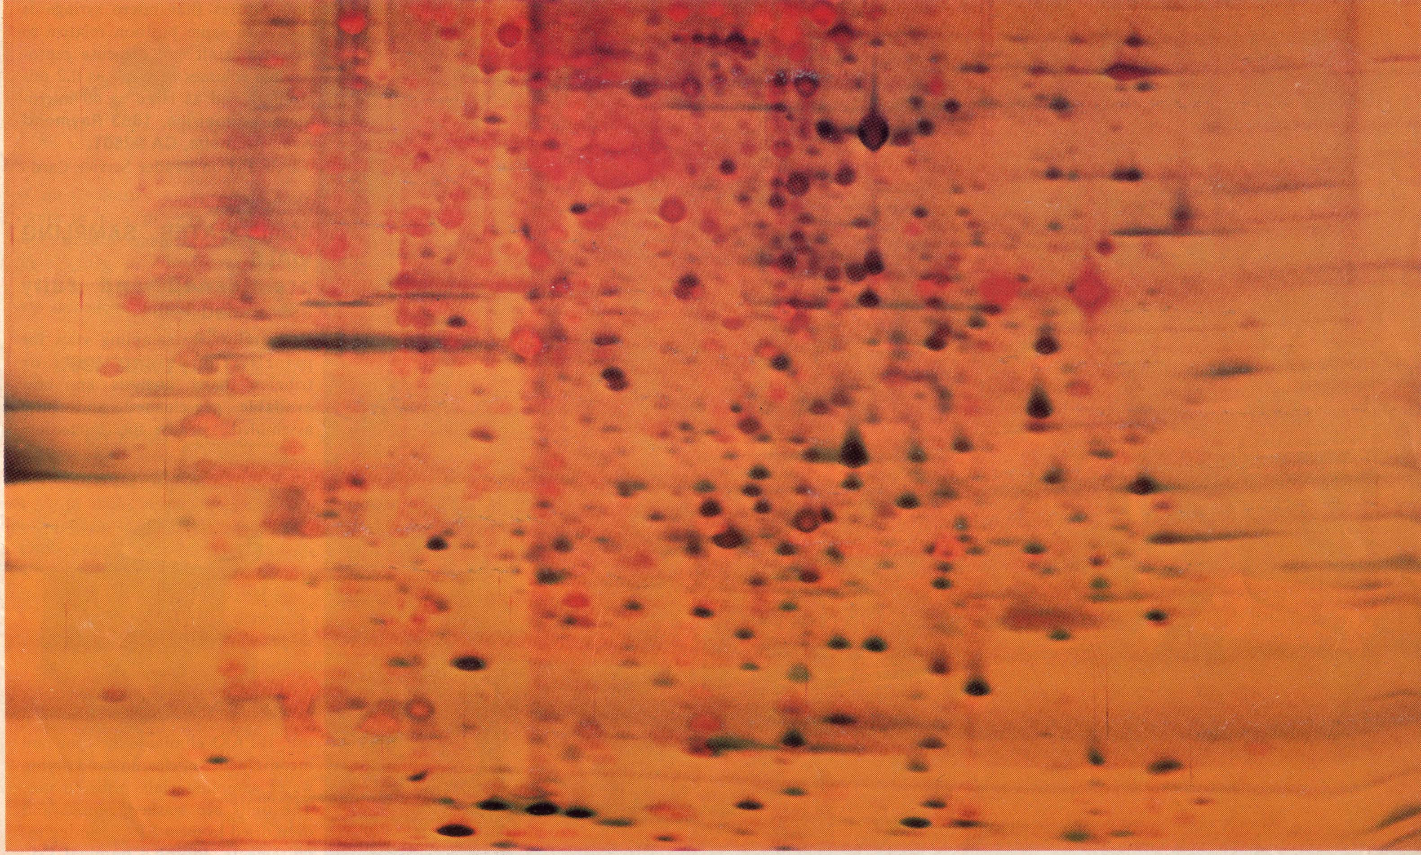
Lo pH
Hi pH
Hi M_{r}
Lo M_{r}
2-gel electrophoresis of E. coli proteins

Slide 24
Centrifugation
Non-equilibrium
Zonal, or Velocity (can be isokinetic)
material layered on top of buffered solution of higher density, or on a preformed density gradient made with sucrose or glycerol
Differential
material pelleted from solution spun at different speeds
Equilibrium (i.e., isopycnic)
Molecules or organelles banded at their density in a density gradient, usually formed during centrifugation using CsCl (for DNA) NaCl (for lipoprotein), sucrose (for organelles), Percol (for organelles), etc.

Slide 25
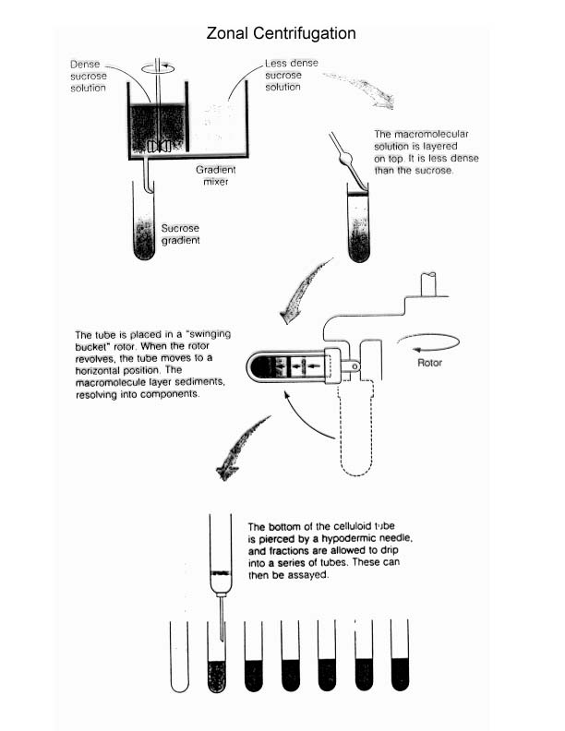

Slide 26
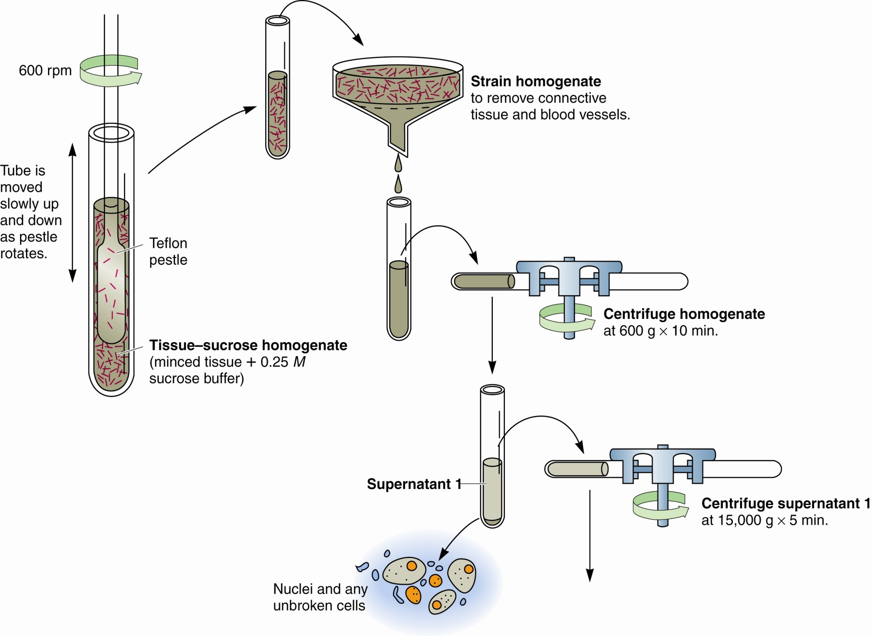
Metabolic Pathways are Compartmentalized Within Cells
Figure 17.16 Fractionation of a cell extract by differential centrifugation.

Slide 27
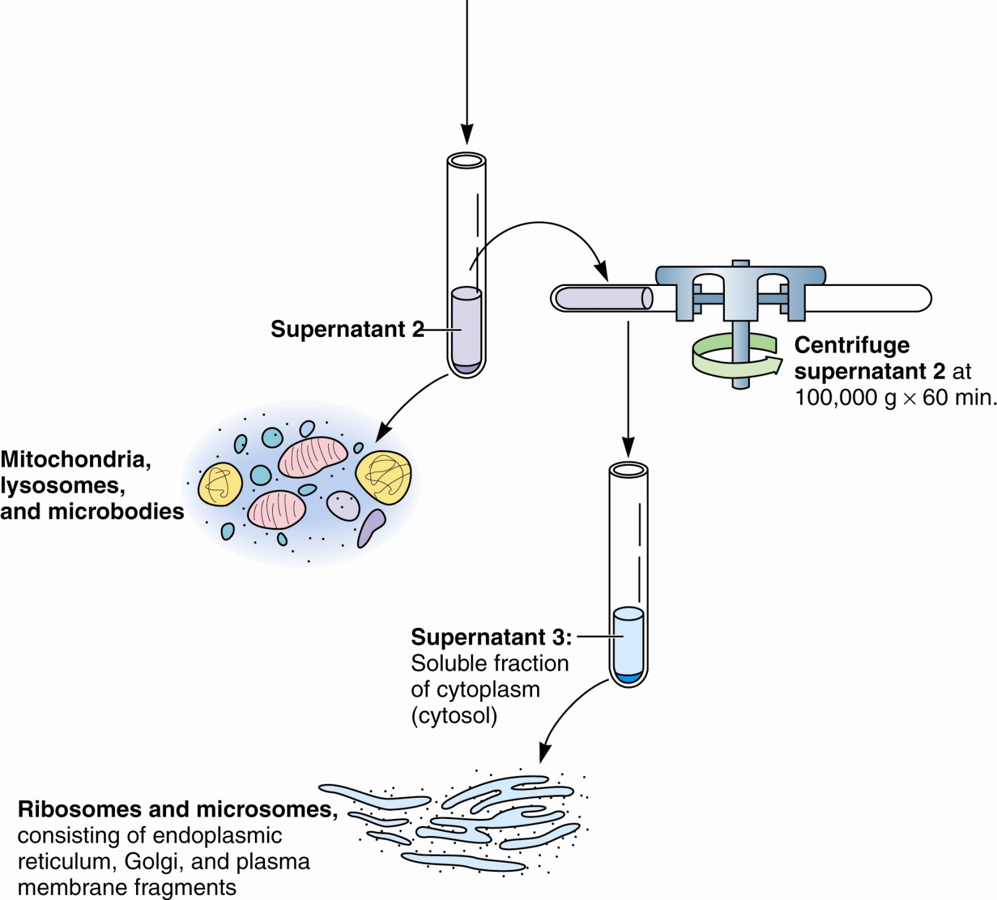
Metabolic Pathways are Compartmentalized Within Cells
Figure17.16
Fractionation of a cell extract by differential centrifugation.

Slide 28
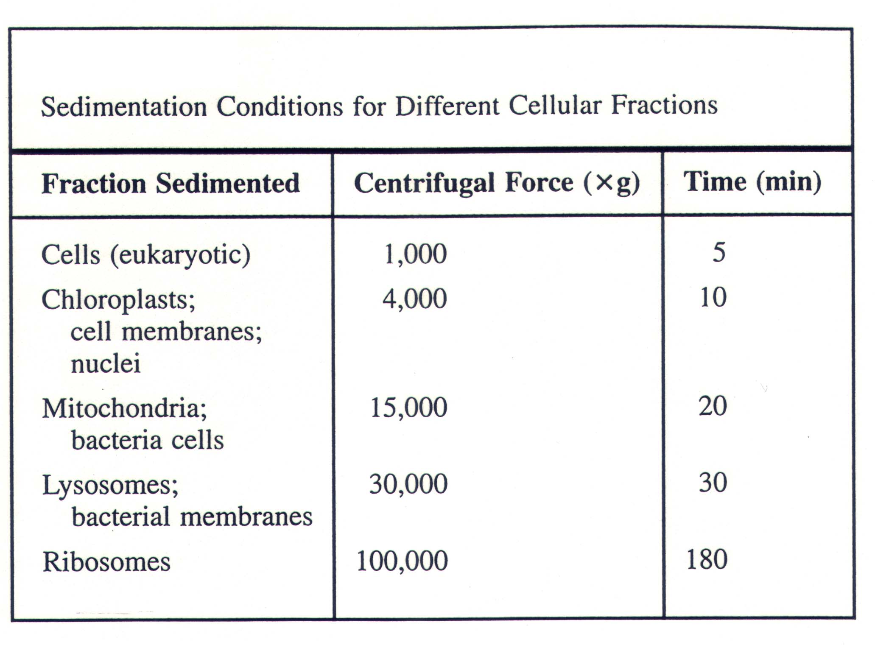

Slide 29
Chromatography
Ion exchange
Anion exchanger has + charged groups
Cation exchanger has – charged groups
load in low [salt]; use gradient of increasing [salt] to elute
Hydrophobic (i.e., Reverse phase)
Resin is hydrophobic
load in polar solution; elute with nonpolar solution
Hydrophobic groups covalently-linked to polar resin
load in high [salt; use gradient of decreasing [salt] to elute
Affinity
Resin carries ligand that binds target protein
elute with solution that disrupts ligand-protein interaction

Slide 30
Chromatography
Gel filtration
Resin is insoluble porous beads
layer protein solution on top of resin column
elute by flowing buffer through the column
Plot log M_{r} v. elution volume to determine apparent molecular weight

Slide 31
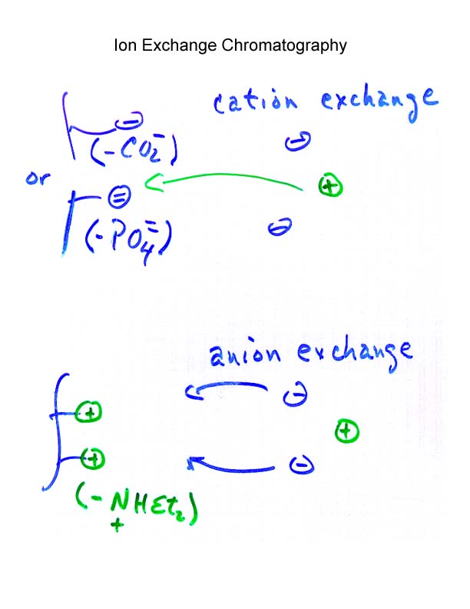

Slide 32
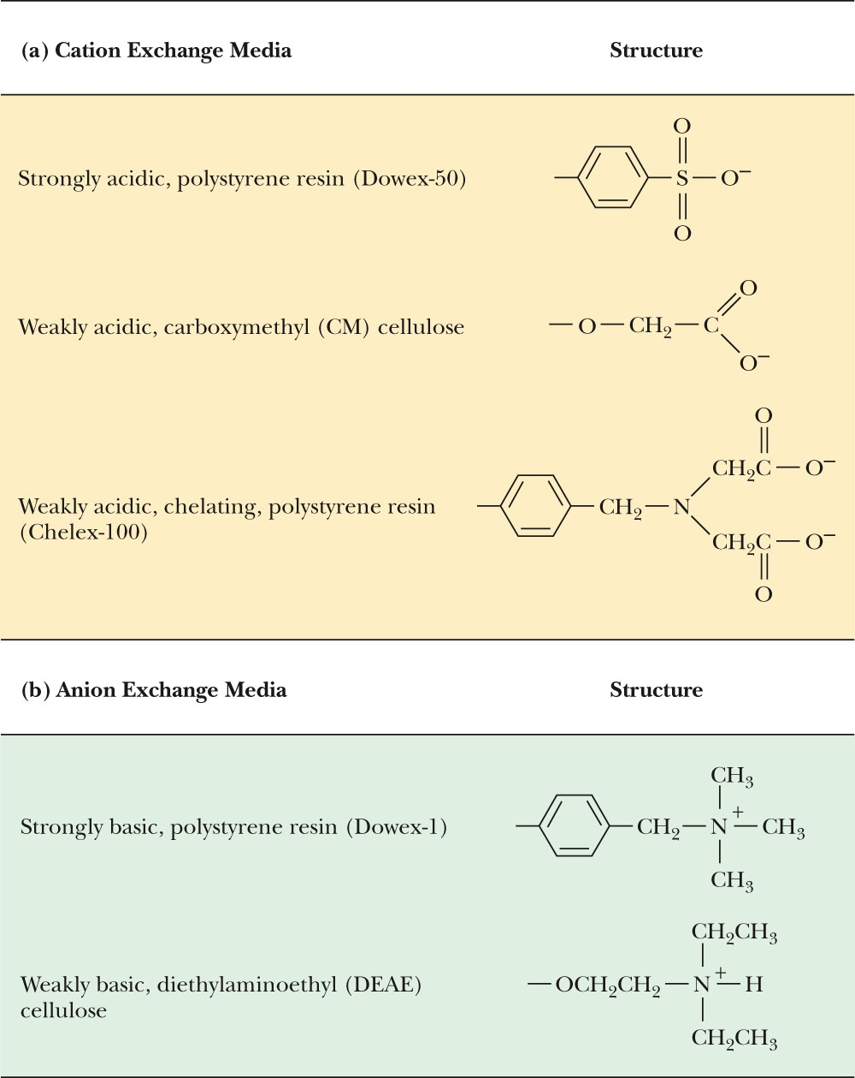
Techniques, Figure 2, p. 112
Cation (a) and anion (b) exchange resins used commonly for biochemical separations.

Slide 33
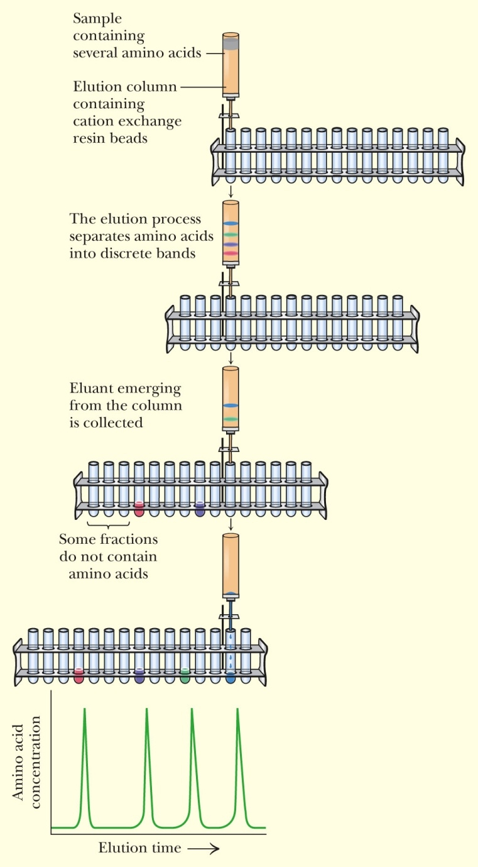
Ion Exchange Chromatography Can Be Used to Separate Molecules on the Basis of Charge
Techniques, Figure 3, p.113
The separation of amino acids (shown as colored bands) on a cation exchange column.

Slide 34
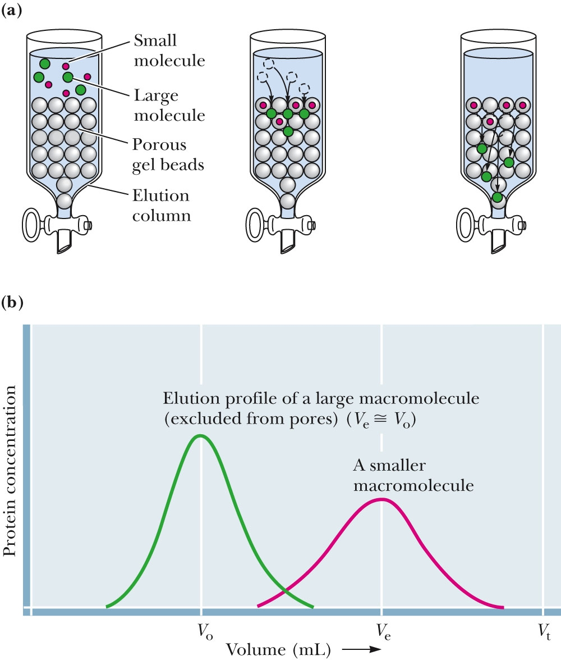
Gel Filtration Chromatography Can Be Used to Separate Molecules on the Basis of Size
Techniques, Figure 4 (a), p. 113
A gel filtration chromatography column. Larger molecules are excluded from the gel beads and emerge from the column sooner than smaller molecules, whose migration is retarded because they can enter the beads.
(b) An elution profile.

Slide 35
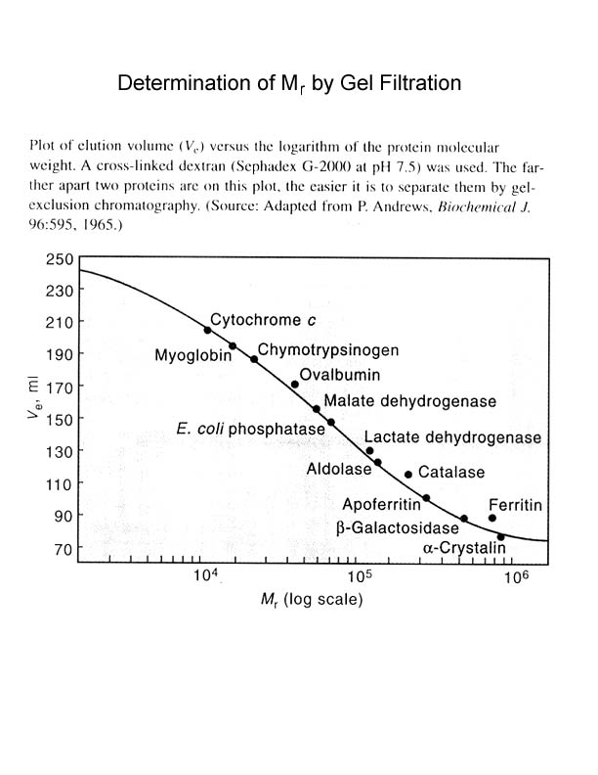

Slide 36
Other Techniques for Macromolecules
Dialysis and Ultrafiltration
Use semipermeable membrane or filter with defined pore size
Fractionation by selective precipitation or solubilization
Salting in
solubilization of protein at mM [salt]
Salting out
ppt. of proteins at M [salt], usually ammonium sulfate
Selective precipitation by heat denaturation
Remove denatured proteins by centrifugation, leaving active proteins in solution

Slide 37
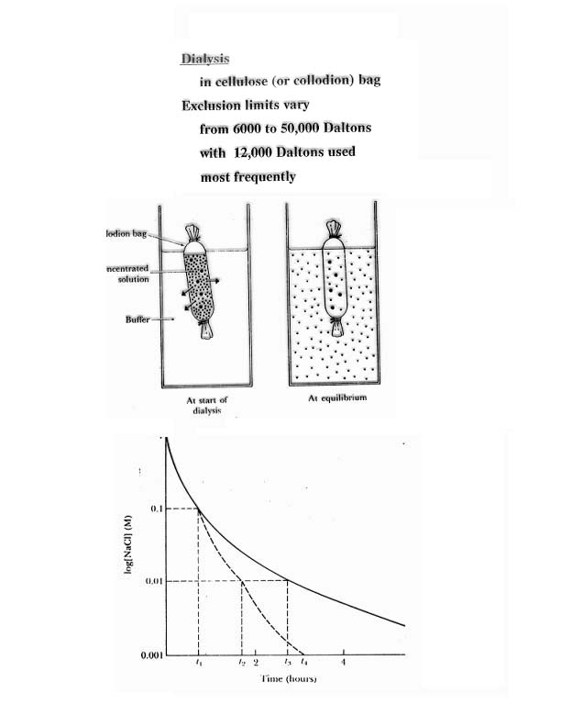

Slide 38
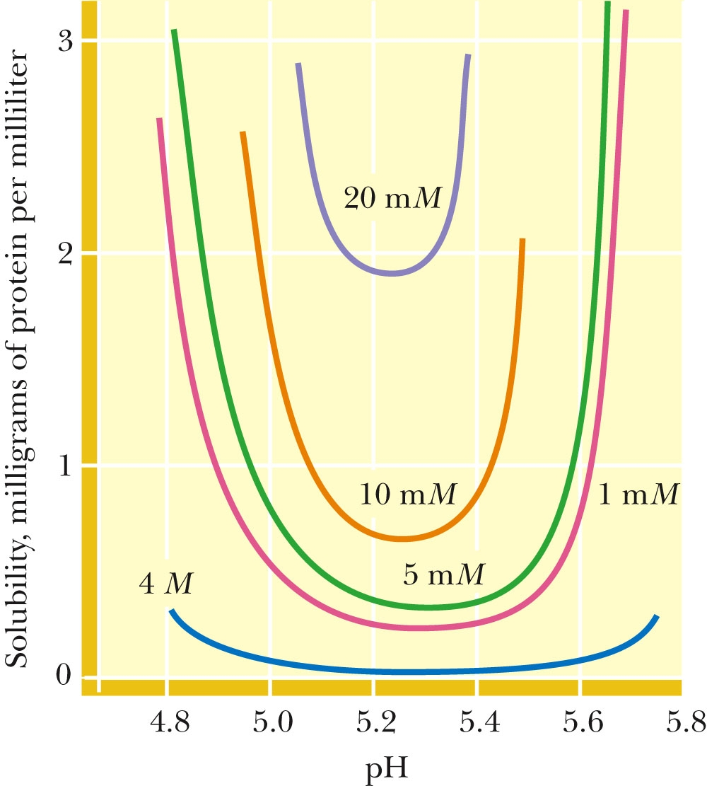
5.2 How Are Proteins Isolated and Purified from Cells?
Figure 5.7 The solubility of most globular proteins is markedly influenced by pH and ionic strength. This figure shows the solubility of a typical protein as a function of pH and various salt concentrations.

Slide 39
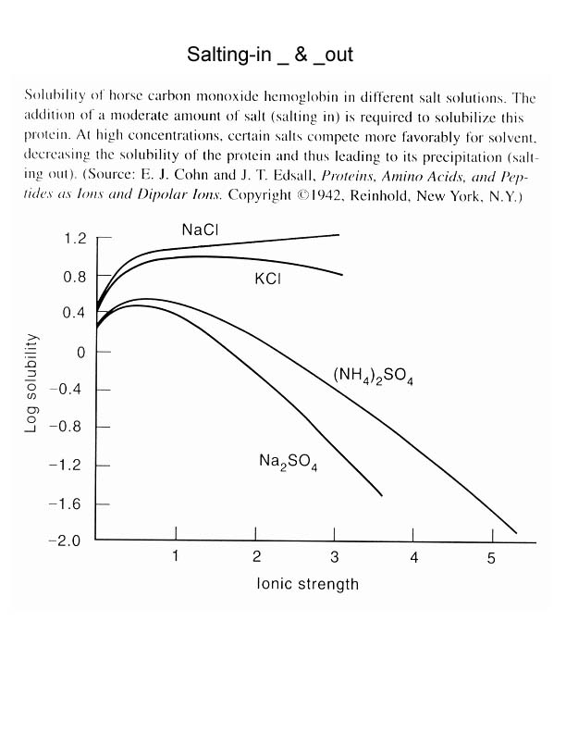

Slide 40
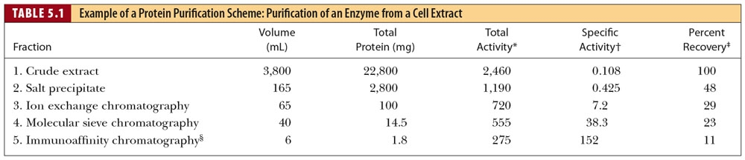
Sec. 5.2 How Are Proteins Isolated and Purified from Cells?
A typical protein purification scheme uses a series of separation methods. Note the dramatic increase in specific activity* of the enzyme through a series of five different purification procedures.
*The term “specific activity” refers to the activity of the enzyme per mg of protein.

Slide 41
